Slide 1
A/B test & Multi-armed Bandit
김설기

Slide 2
소개 (scope)
서비스에서 실험
Multi-Armed Bandit 이 무엇인가?
Limitation of A/B test in online service
Experiment / specific case (추천엔진)
Thompson Sampling ()
ORTS
Python 모듈 및 R 관련 패키지
채용

Slide 3
온라인 버전: sulgik.github.io/r4ds

Slide 4
Experiment Module
서비스업이 제조업과 구분되는 점은, 제품/서비스 출시 이후에도 “실험”을 통해 지속적인 개선을 할 수 있다는 것이다 (ref)
ref. SL Scott, 2014, Multi-armed bandit experiments in the online service economy

Slide 5
Experimentation Platform
제품 출시 이후에도 “실험”을 통해 지속적인 개선을 할 수 있다는 것이 서비스업이 제조업과 구분되는 점이다 (ref)

Slide 6
A/B 테스트와 Multi-armed Bandit (MAB)
A/B 테스트의 한계
Strict: 실험기간과 실험 variant 가 사전에 설정되어야 함
Sequential Decision Making 에 활용하기 불편함
Multi-armed Bandit (MAB)
“Problem (or model) of how fixed set of resources must be allocated between competing choices when choice’s properties are only partially known” – wikipedia

Slide 7
Inference in AI application: Online Evaluation
Recommender System Project
Performance
0.46
0.50
0.20
Notes:
Typical way for this task is first to prepare multiple deep learning models.
In my team, other researchers also prepare multiple complex recommender models, such as GNNs.
Then allocate each of these models to part of user groups.
The, observe the performance such as how much user like it or click it.
We see different performance, and considering variability of these metrics, we reallocate in next round.

Slide 8
Inference in AI application: Online Evaluation
Recommender System Project
Performance
0.40
0.52
Notes:
Then we obtain new performance, then finally now we obtained the best deep learning model.

Slide 9
Inference in AI application: Online Evaluation
Recommender System Project
Allocation method is called “Policy”
Popular Policy: Thompson Sampling
Notes:
This process is called online evaluation, and it is very standard way in service such as google, facebook and LINE messenger.
Allocation method is called “Policy”, and this will determine the efficiency of the system.
Popular method is logistic Thompson sampling, and in fact, this corresponds to basic Reinforcement learning model.

Slide 10
Thompson Sampling (Probability-matching strategy)
Posterior 분포
$P\left(θ | D\right)∝P\left(D | θ\right)P(θ)$, where $θ$: parameter, $D$: past observations
Arm a* 를 다음의 확률로 선택한다.
$∫I\left[a^{∗}=argmax_{a} E\left(r|a,θ\right)\right]P\left(θ | D\right)dθ$
8 / 17

Slide 11
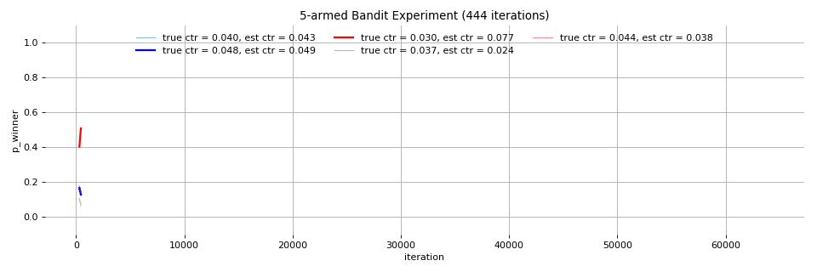
Show Lu, “Beyond A/B Testing: Multi-armed Bandit Experiments”
Notes:
This is good animation showing how posterior distributions are being updated by Thompson sampling.
So once we have posterior distribution, we can choose an arm using these distiribution, obtain new observation and update the distribution.

Slide 12
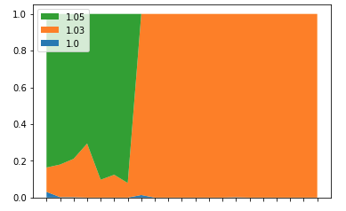
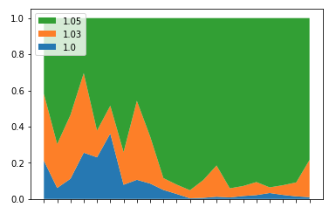
Robustness
Full Rank Thompson Sampling
Odds Ratios Thompson Sampling
14 / 17

Slide 13
채용
MAB can be used for more flexible experiment module
Translation “R for Data Science”
Notes:
Typical way for this task is first to prepare multiple deep learning models.
In my team, other researchers also prepare multiple complex recommender models, such as GNNs.
Then allocate each of these models to part of user groups.
The, observe the performance such as how much user like it or click it.
We see different performance, and considering variability of these metrics, we reallocate in next round.

